Slide 1
Domestic Reform attempts 1961-62
Economic recession 1961-1962
Introduces tax cuts. Reduces top rate from 90% to 70%
Persuades Steel Companies to limit price increases
Economy recovers fast….growth up from 1% to 5% 1962..1963
Social reforms Introduced
Equal Pay Act to end sexual discrimination
Increases to minimum wage
Manpower Retraining Act
Mental Health Act
September 1962…. Spy planes reveal strange construction in Cuba

Slide 2
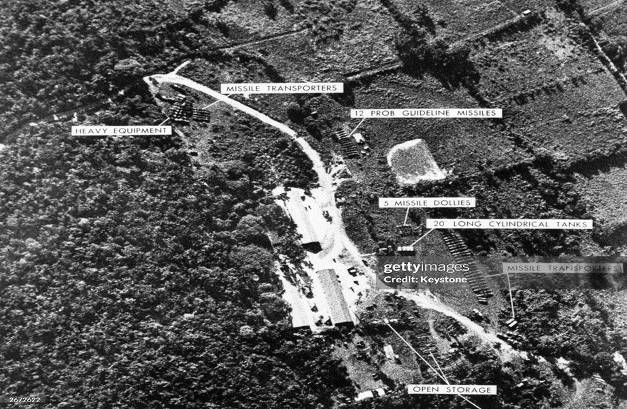
Cuban Missile Crisis
October 14th: Spy Plane photos of missile sites
Russians assume US about
To invade Cuba
Want to offset missile inferiority
October 1-14
USSR delivers missiles in
secret, deployed across
Cuba + 40,000 soldier

Slide 3
Kennedy holds Emergency Executive Meeting October 16 Options: Bomb, invade, blockade
Kennedy to air force: “ can you eliminate them all. ….90%
….decide blockade….rename “Quarantine". Order USSR to remove

Slide 4
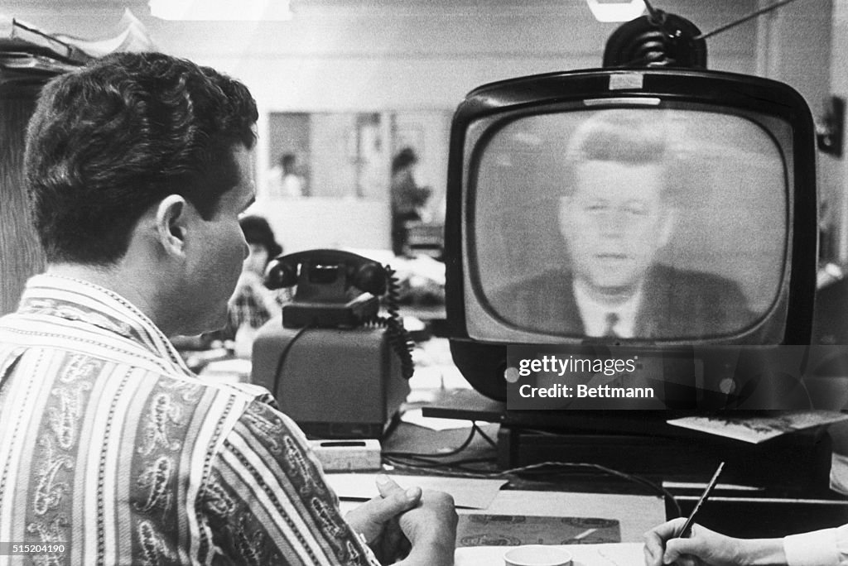
USSR denies missiles exist October 18 Kennedy addresses nation October 22

Slide 5
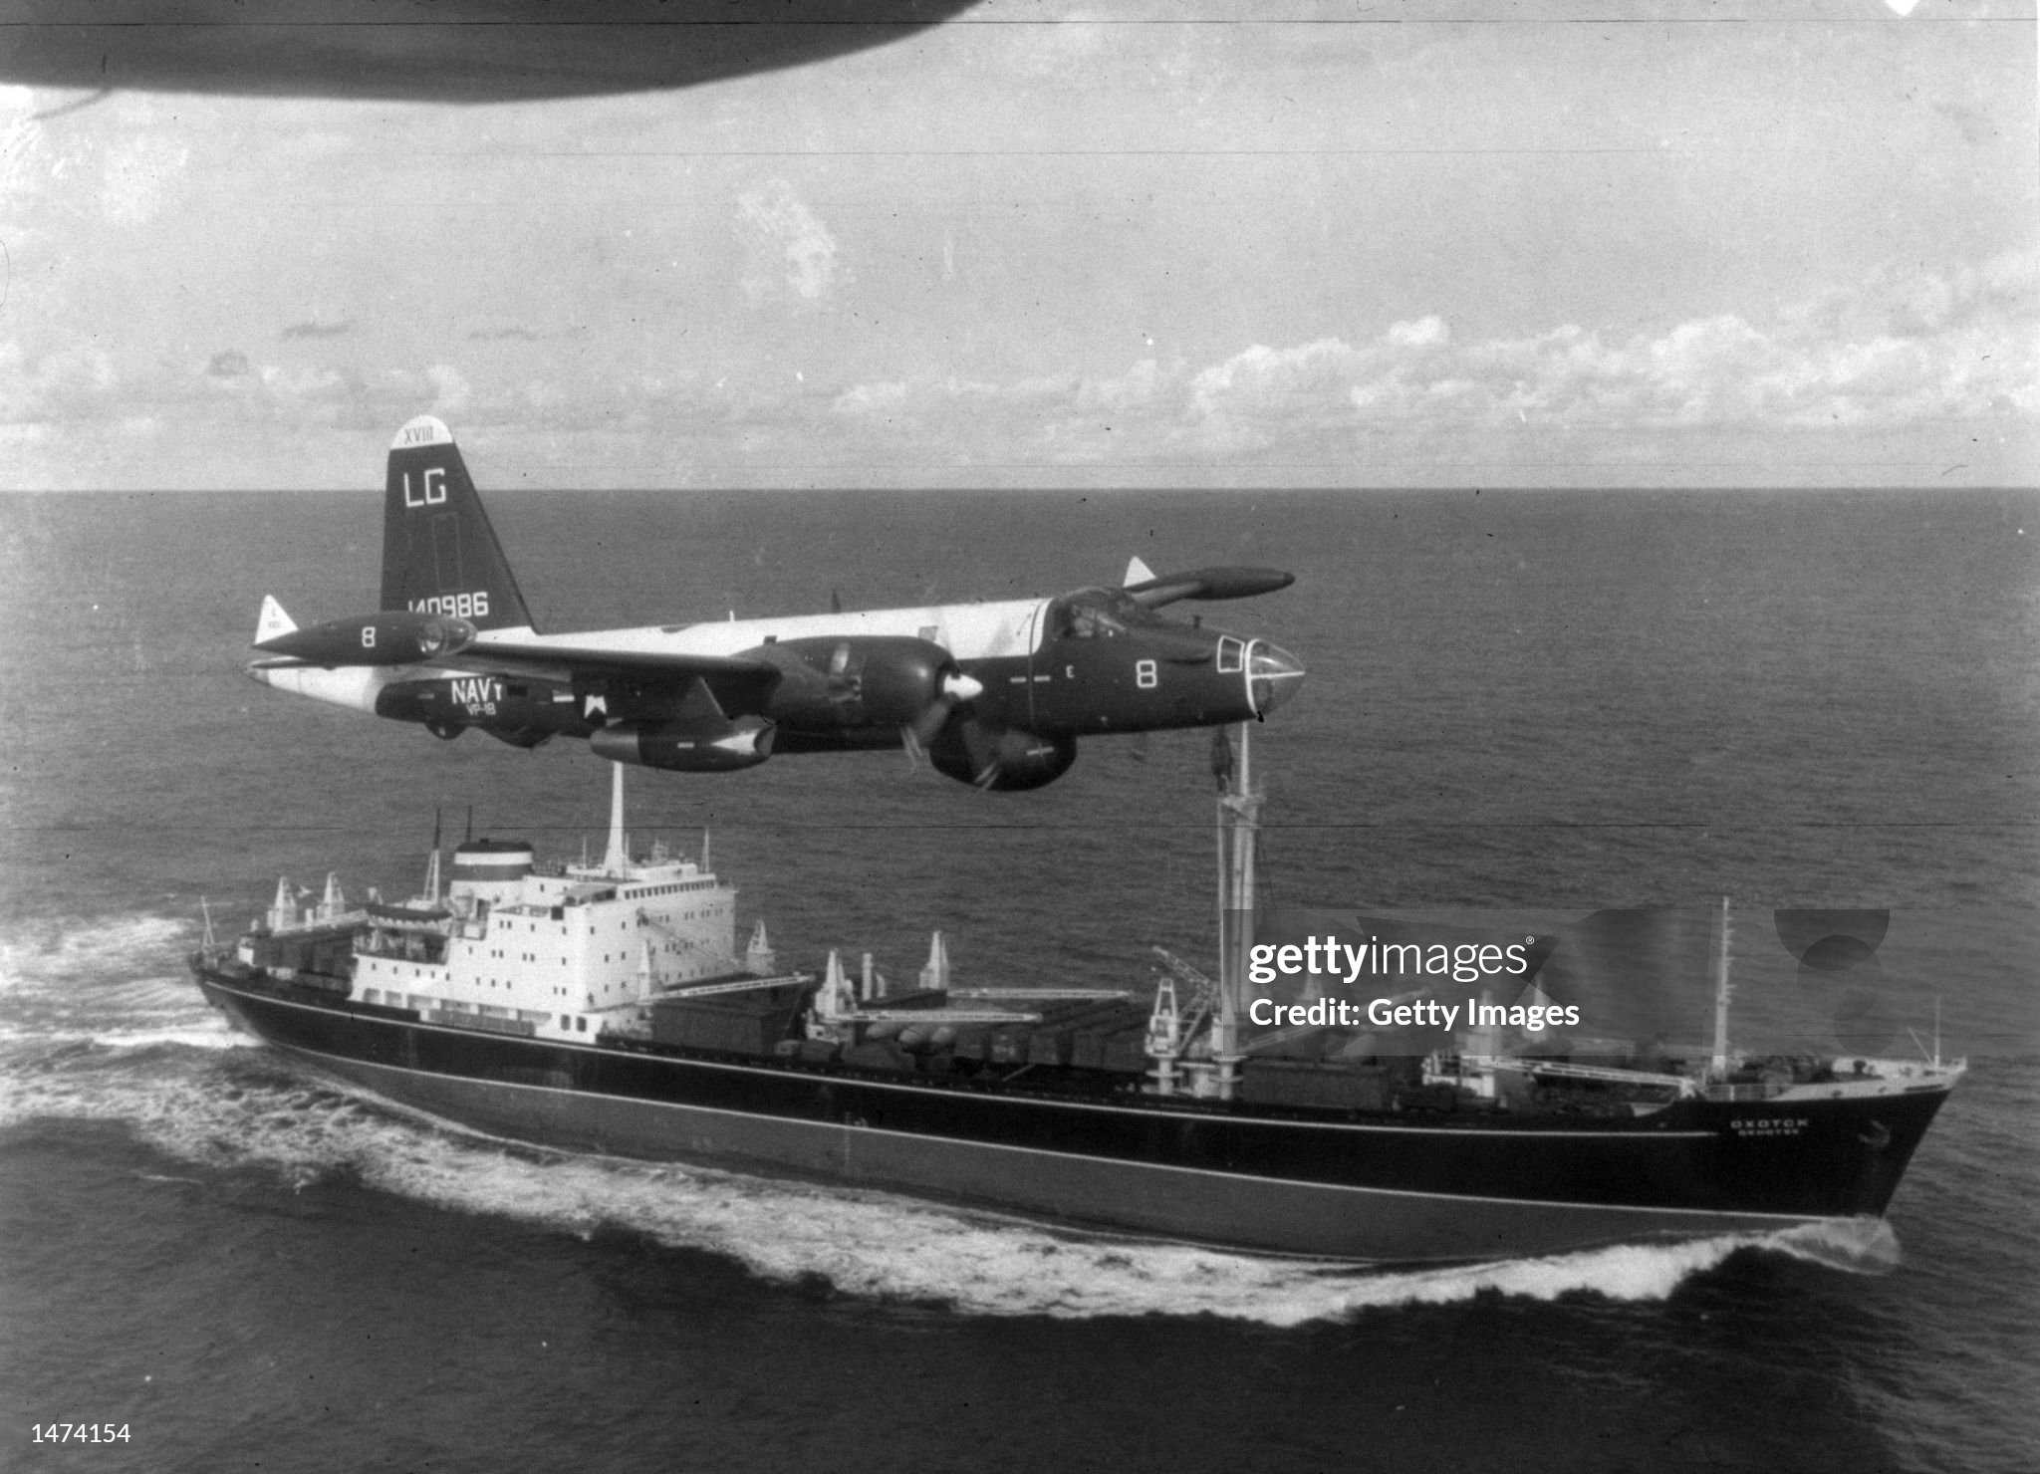
US air force deployed….shadow approaching Soviet ships heading for Cuba…Khrushchev denies missiles…accuses US of aggression

Slide 6
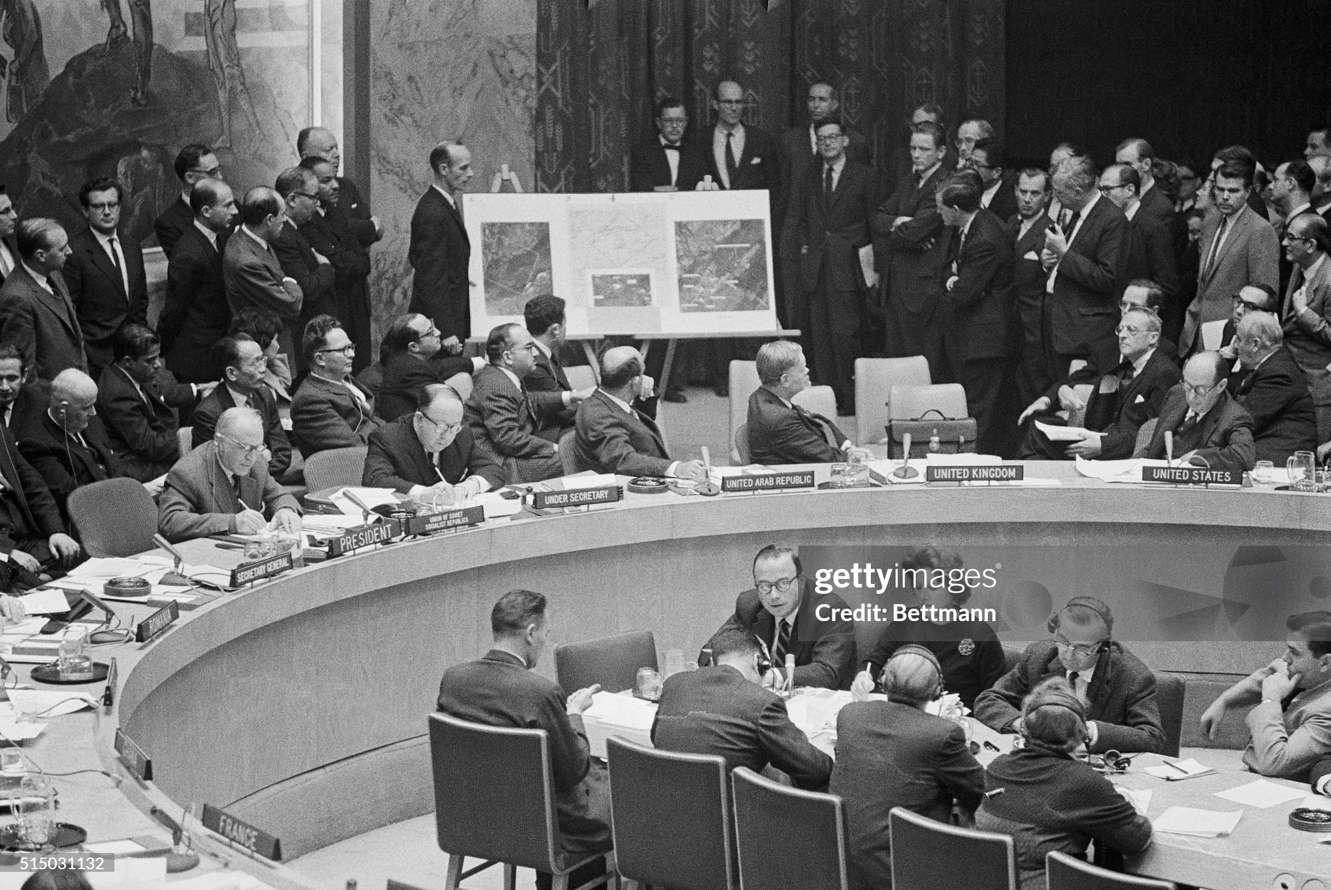
October 22nd..confrontation in UN …Russians deny….US to Defcon-2 nuclear alert

Slide 7
Negotiations
US fleet establishes blockade…Bobby Kennedy sent to meet USSR ambassador
October 26…Khrushchev letter 1…(public): offers to withdraw missiles if (1) US promise not to invade
October 27…Khrushchev letter 2….(private): Demands US remove missiles from Turkey…will not remove missiles from Turkey

Slide 8
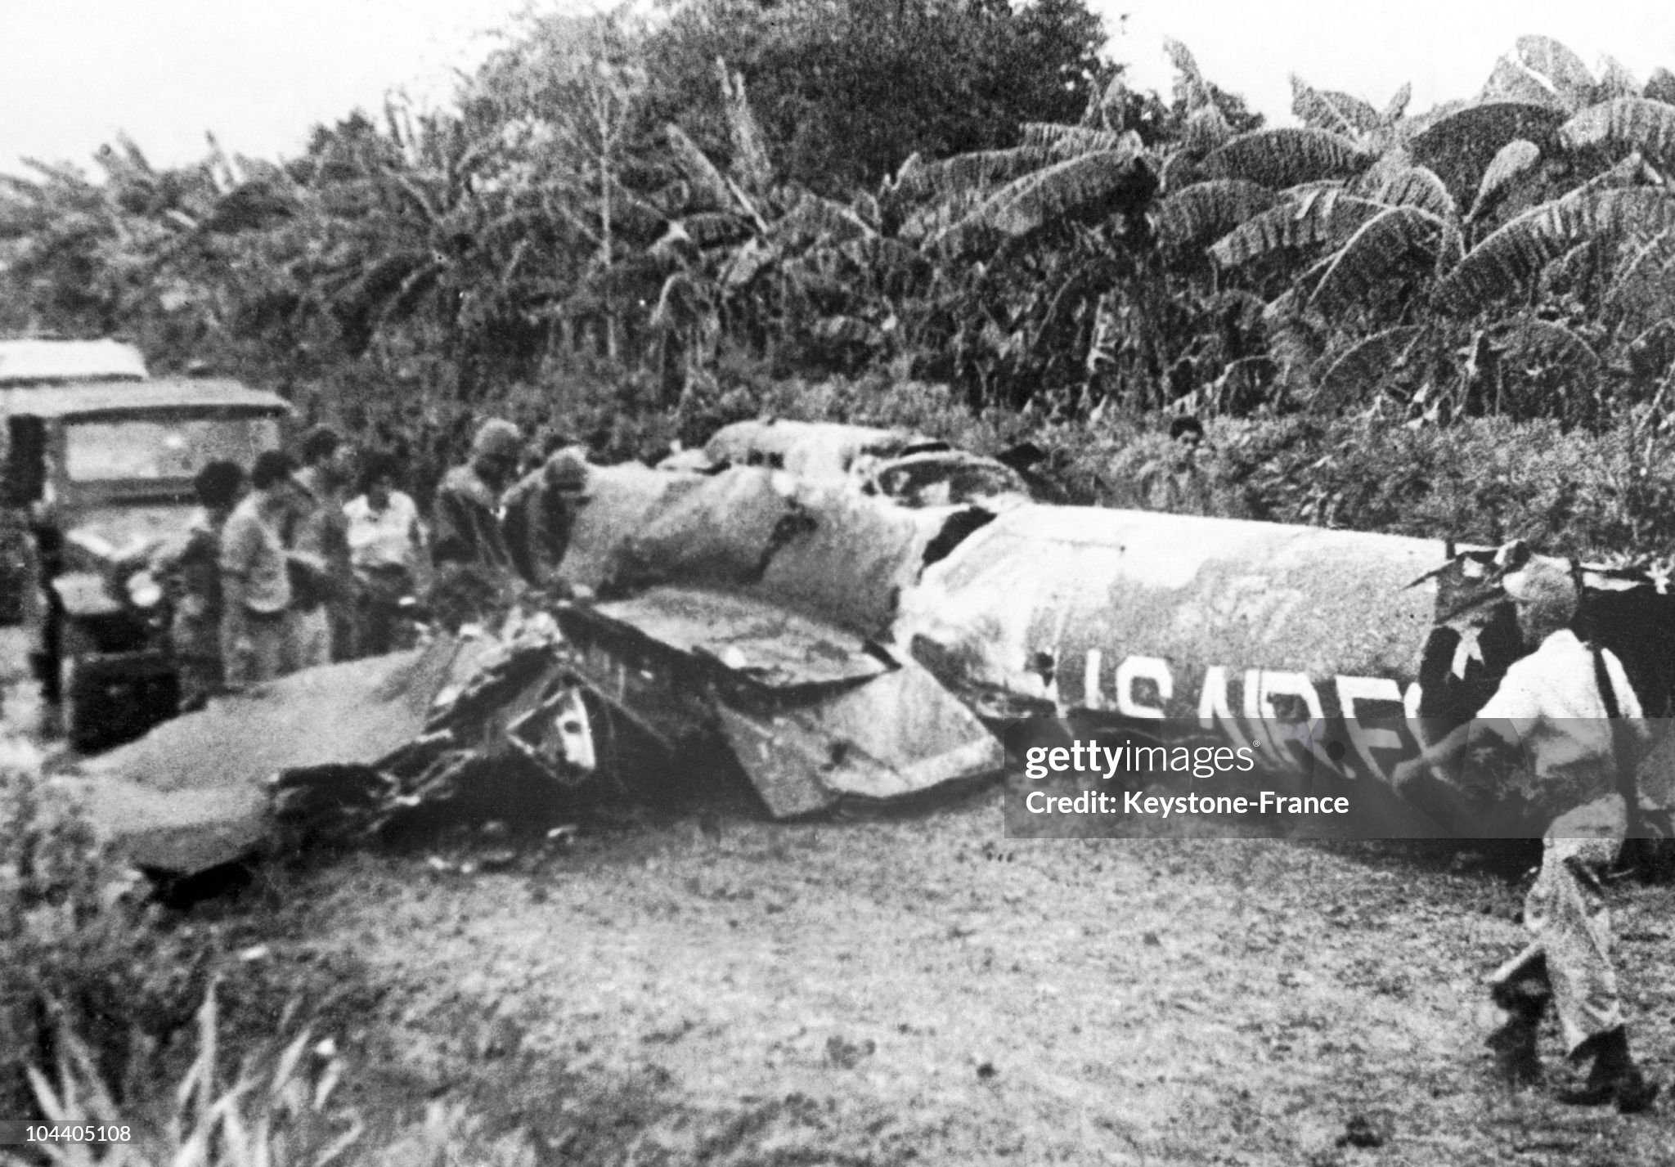
October 27th Cuba shoots down spy plane…US prepares to attack…naval blockade in place

Slide 9
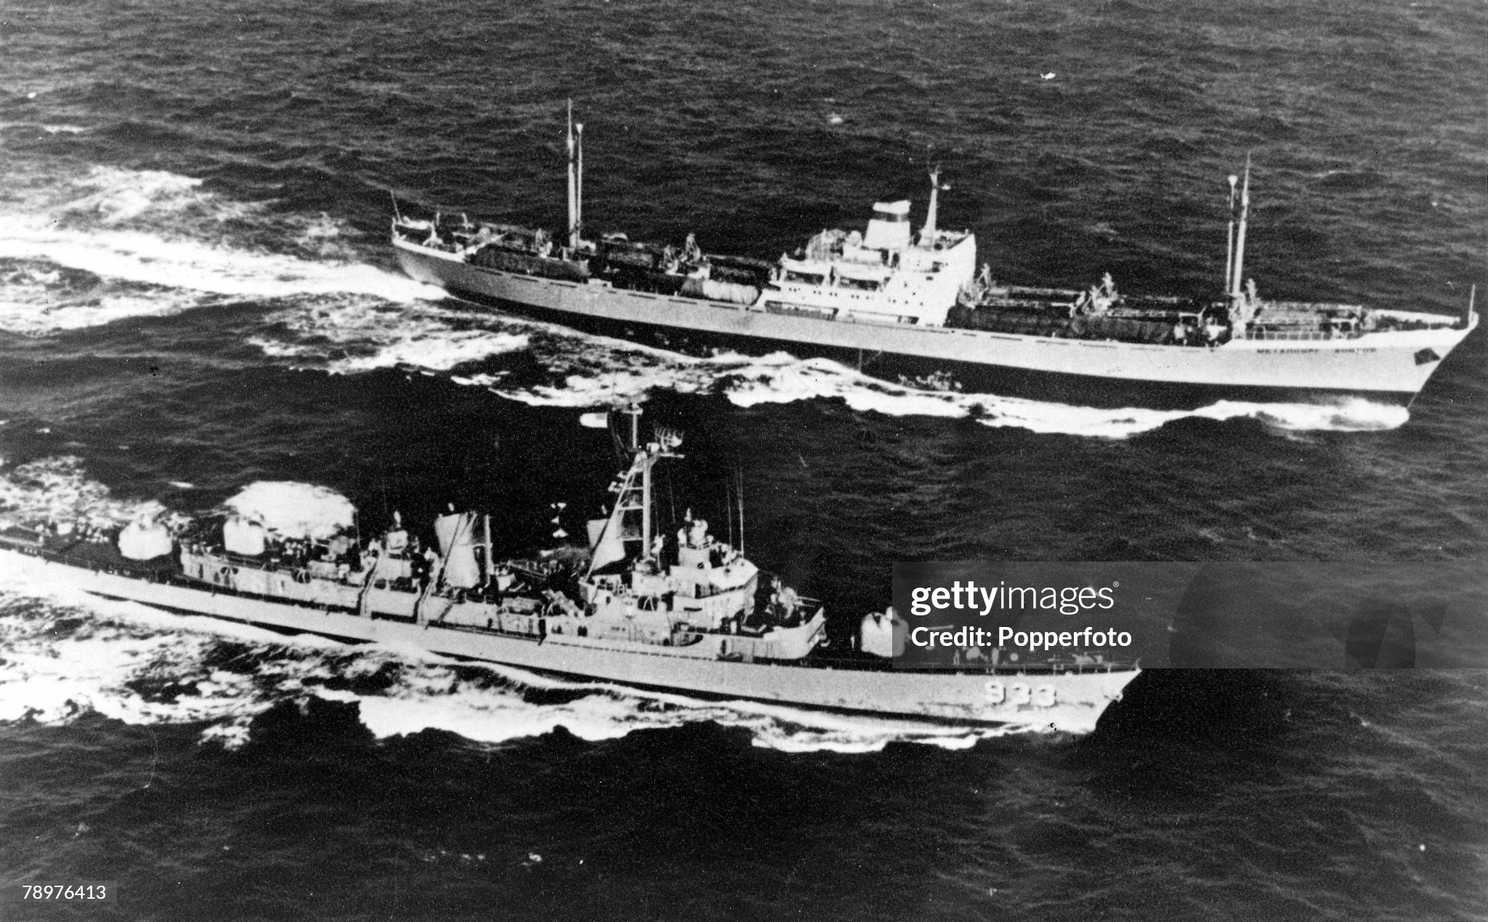
October 28thUS Navy intercepts Russian Ships …ships continue to Cuba

Slide 10
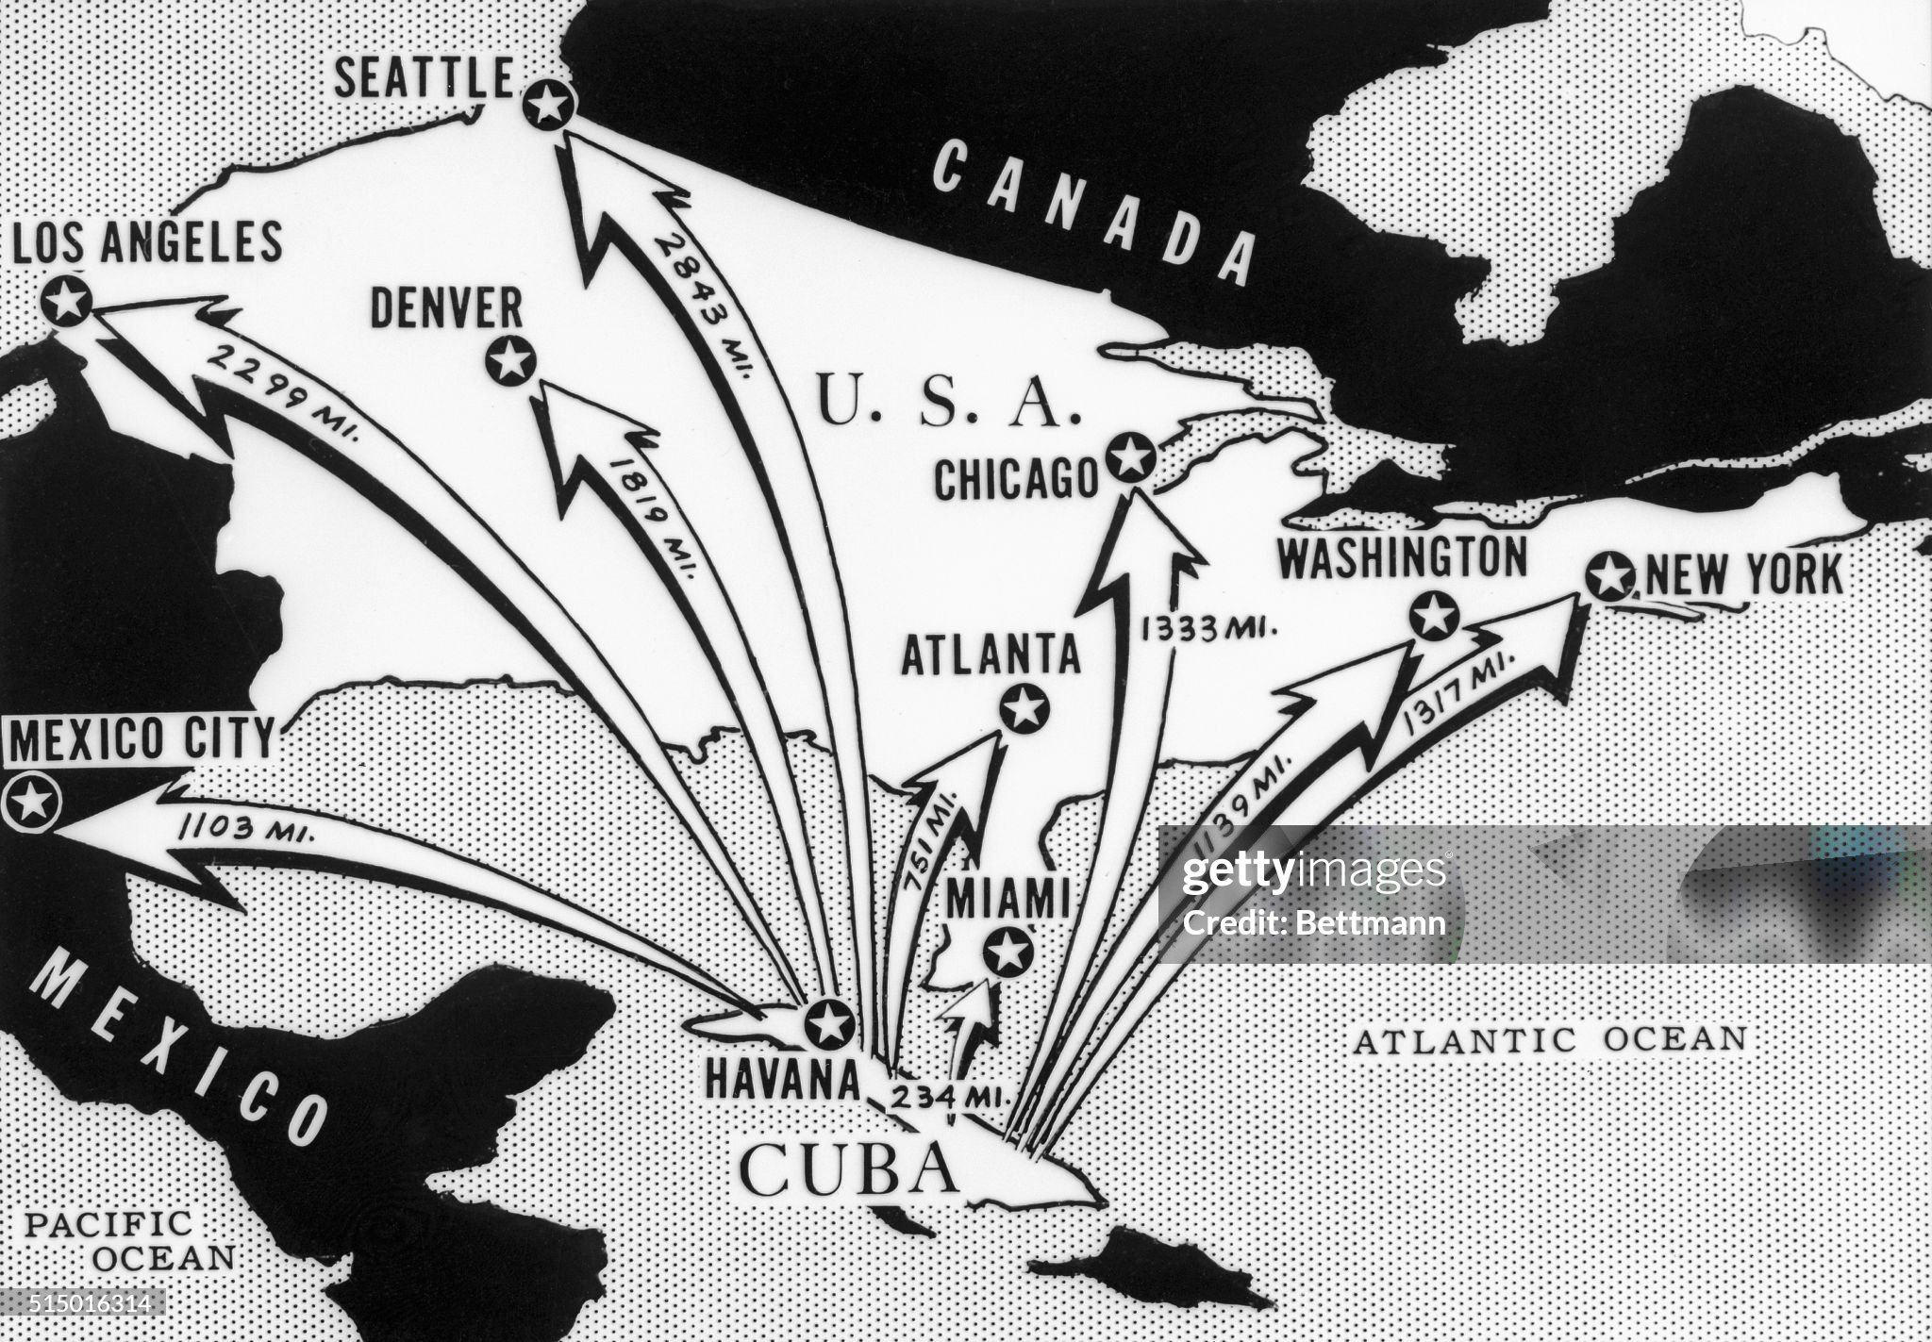
US media expects attack….(Chicago Sun Times)

Slide 11
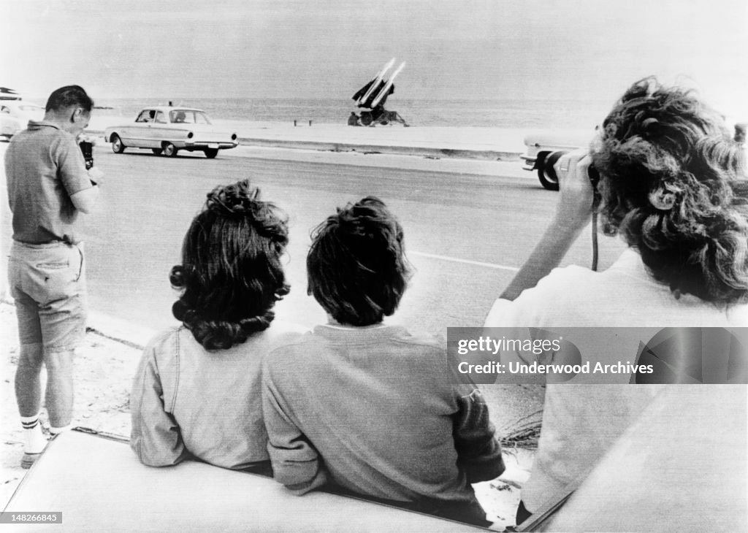
US army prepares to invade ….US missiles on Florida beaches

Slide 12
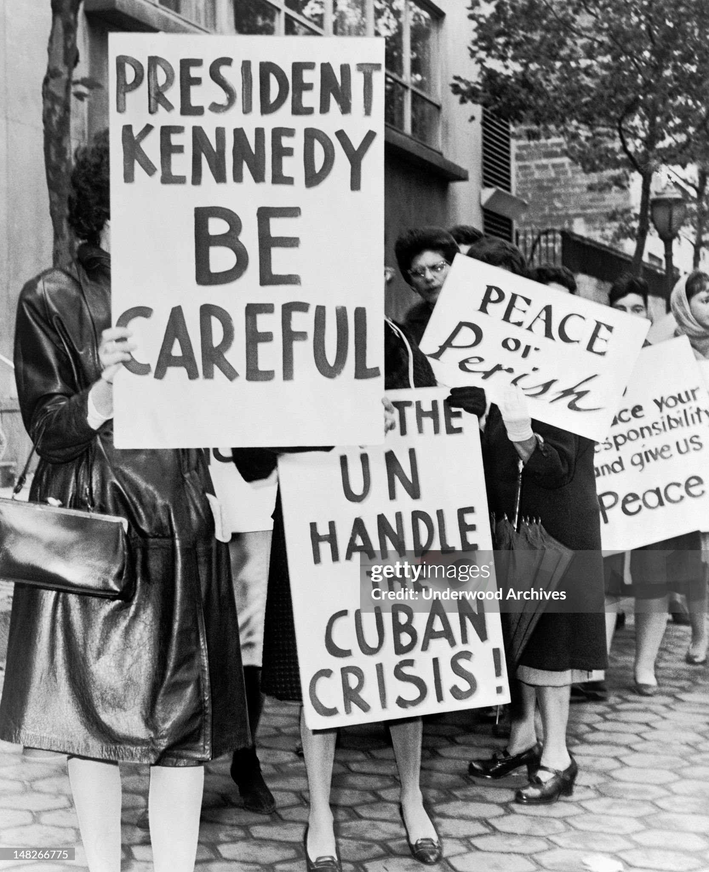
World expects war

Slide 13
Resolution
Kennedy ignores letter 2
…..offers to promise no invasion
“private agreement: US will remove missiles from Turkey 6 months after missiles gone from Turkey
……on condition this kept secret
October 28th Russia backs down…agreement made
Russian ships turn back
Khrushchev agrees to remove missiles...keep Turkey missile agreement secret
World celebrates…Kennedy hero…Kutcher humiliated

Slide 14
Aftermath
USA and USSR realise one mistake= mutual annihilation
Negotiations to reduce tensions
Agree banning of above ground nuclear tests
Establish hot line for direct communications
First discussions on potential scale down arms race…..beginning of Détente
Kennedy blocks CIA Castro assassination plots
Attention shifts to Containment…….Vietnam

